Slide 1
Hospital Readmissions Analysis Ironhack Data Analytics Bootcamp Final Project
Presented By: Asli Veenstra
Last updated: February 2nd, 2023
https://github.com/aslivns

Slide 2

Diabetes 130-US hospitals for years 1999-2008 Data Set Assess if initial diagnoses, number of procedures, or other variables could help better understand the probability of readmission. Some doctors believe diabetes might play a central role in readmission. Explore the effect of a diabetes diagnosis on readmission rates.

Slide 3
Conclusion:
Diabetes 💔 Your Heart

Slide 4
Type 2 Diabetes
More than 37 million Americans have diabetes
Approximately 90-95% of them have type 2 diabetes
Type 2 diabetes most often develops in people over age 45

Slide 5
How Diabetes Affects Your Heart?
High Blood Pressure
Too much LDL (“bad”) cholesterol
High triglycerides
Force of blood through your arteries and can damage artery walls
Can form plaque on damaged artery walls
Contribute to hardening of the arteries

Slide 6
Can Type 2 Diabetes Be Prevented? YES!
Follow a healthy diet
Aim for a healthy weight
Get active
Manage stress
Don’t smoke
🚬

Slide 7
Hospital Records for Every Visit
Encounter id
Patient id
Age: (0-10), (10-20), …, (90-100)
Gender: Male, Female
Admission Type:
Emergency room,
Referral,
Transfer from another hospital etc.
Discharge:
To home,
Transfer to another hospital
To home with medical care
Expired etc
Readmitted: Yes:1 No:0
Primary Diagnosis
Secondary Diagnosis
Third Diagnosis
Circulatory,
Diabetes,
Respiratory,
Endocrine,
Digestive,
Injury-poisoning etc.

Slide 8
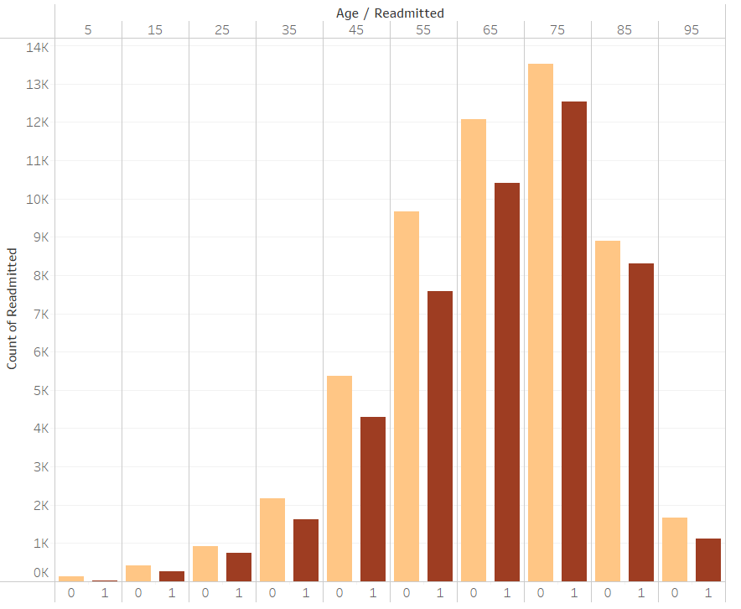

Age vs Readmission

Slide 9
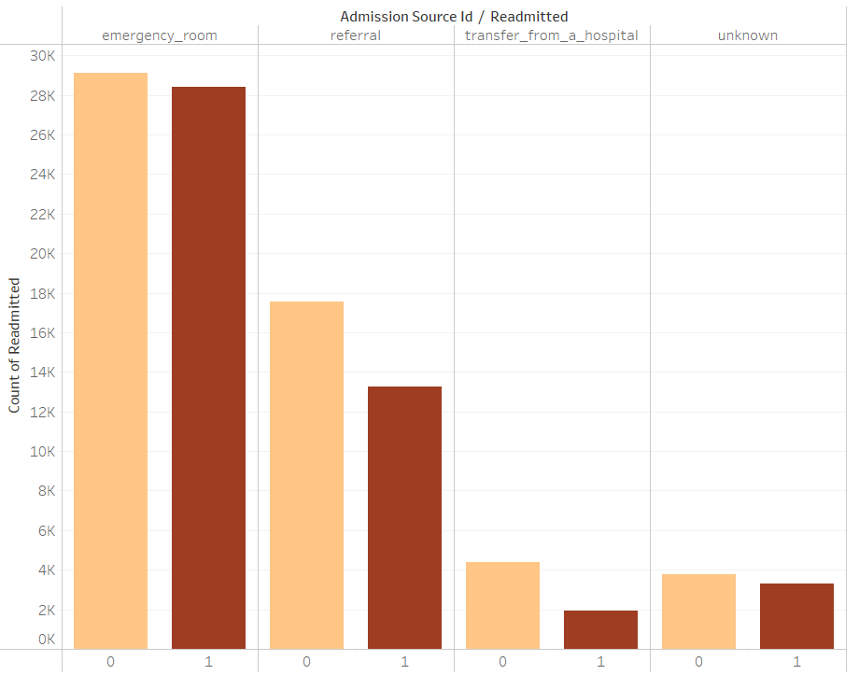
Admission type vs Readmission

Slide 10
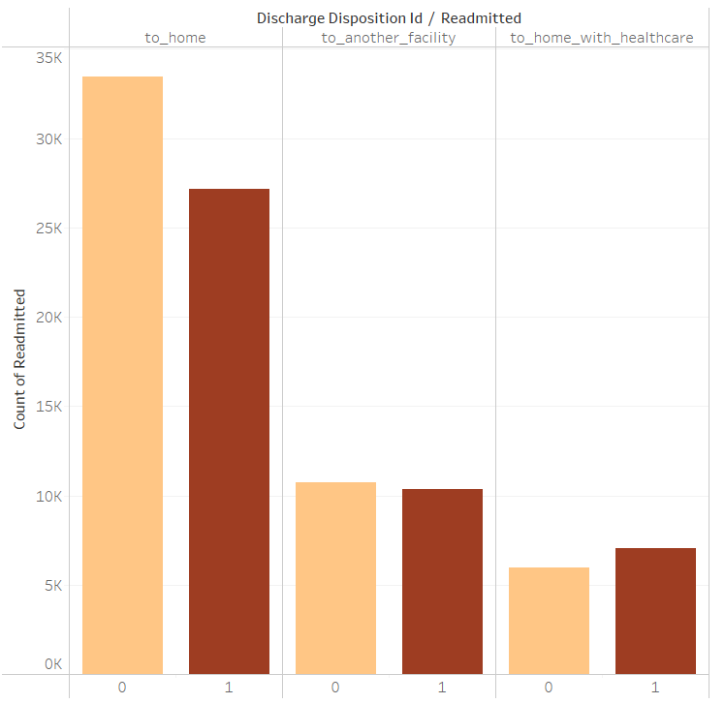
Discharge type vs Readmission

Slide 11
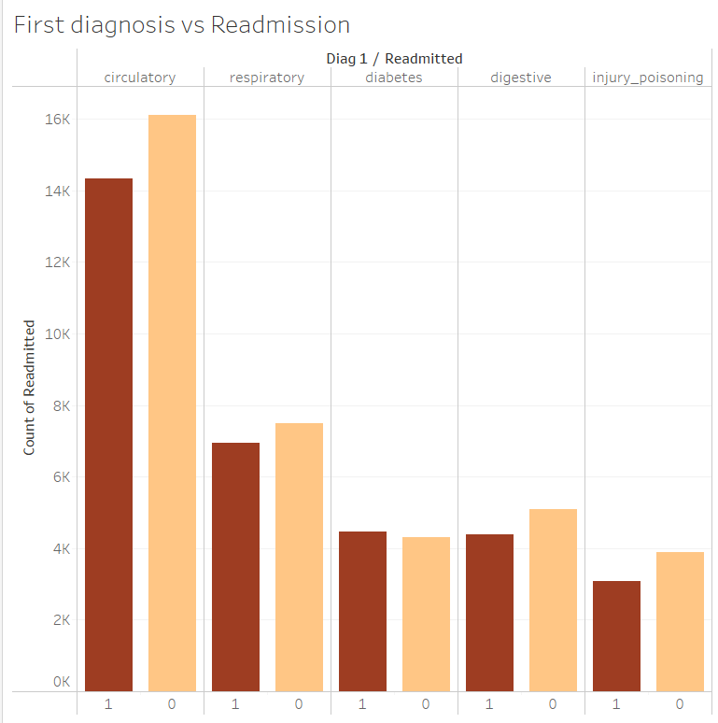
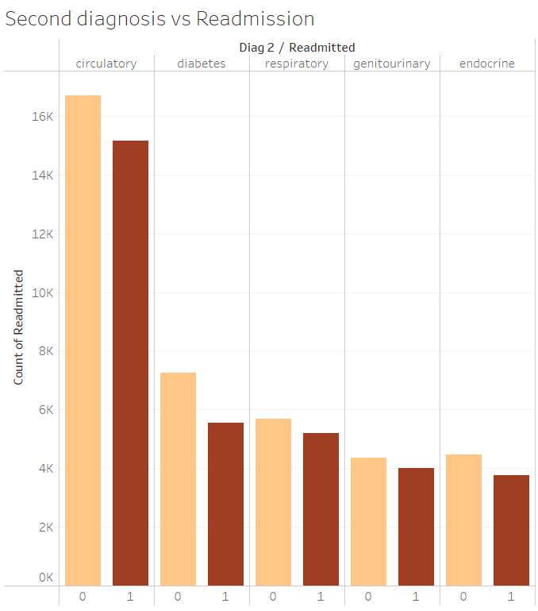
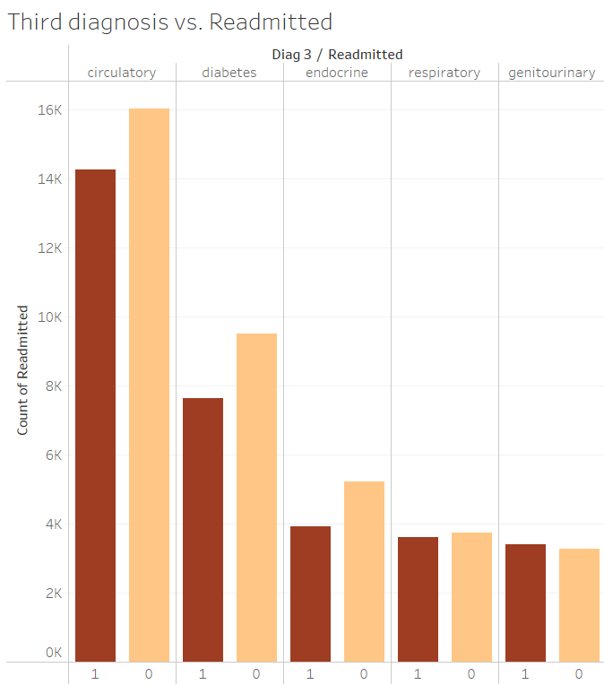
Diagnosis vs Readmission

Slide 12
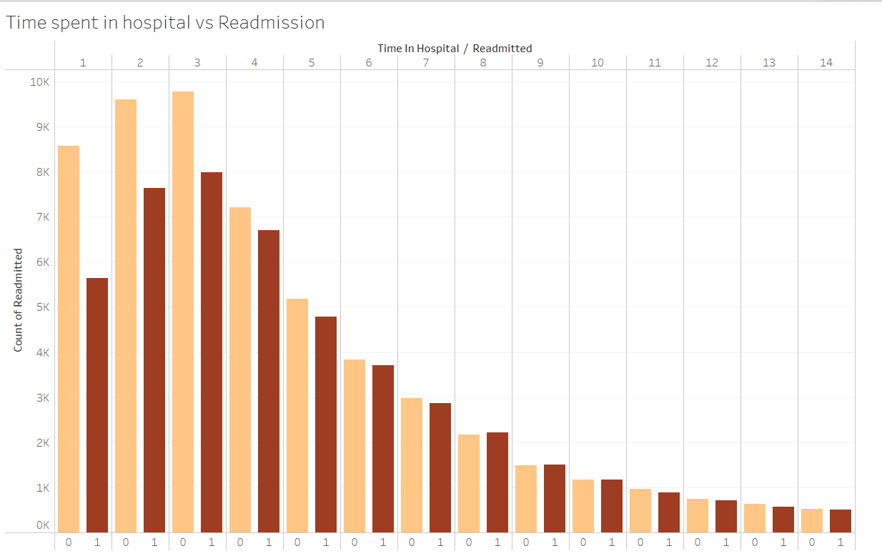
Time Spent in Hospital vs Readmission

Slide 13
Readmission Predictions
01
02
03
Random Forest Classifier
score: 0.70
precision: 0.68 ( true pos / true pos+false pos )
recall: 0.67 ( true pos / true pos+false neg )

Slide 14
About the patient.. Who is more likely to come back?
Age above 50,
Patient who is admitted to emergency room,
Patient with circulatory complaint-diagnosis,
Patient who stayed in the hospital between 3-5 days,
Patient who is discharged to home

Slide 15

Thanks..
Do you have any questions?
asliveenstra@gmail.com

Slide 16


